Slide 1
Doctors Community Hospital Expansion
Lanham, Maryland
Daniel Alexander
BAE/MAE in Construction Management
Senior Thesis Presentation 2009
The Pennsylvania State University

Slide 2
Presentation Outline
Project Overview
BIM Execution Planning Analysis
Prefabricated Façade Analysis
  Demonstration of Breadth
Site Logistics Analysis
Final Conclusions
Q & A

Slide 3
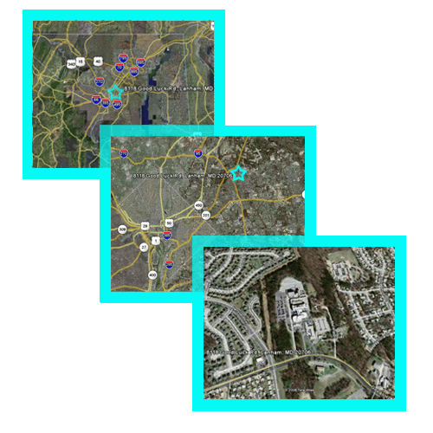

Project Overview
Location: Lanham, MD
Owner: Doctors Community Hospital
CM at Risk: Gilbane Building Co.
Project Overview
BIM Execution Planning Analysis
Prefabricated Façade Analysis
  Demonstration of Breadth
Site Logistics Analysis
Final Conclusions
Q & A

Slide 4
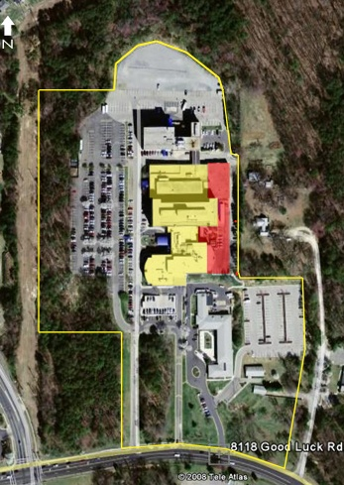
Project Overview
3 Story Expansion above existing 2 floors
Goal: Expand and Improve Hospital
  Expand 1st Floor Emergency Department
  Expand patient tower
  Renovate existing patient tower
Project Overview
BIM Execution Planning Analysis
Prefabricated Façade Analysis
  Demonstration of Breadth
Site Logistics Analysis
Final Conclusions
Q & A
Renovate Existing Patient rooms
5 Story Expansion
ED Expansion

Slide 5
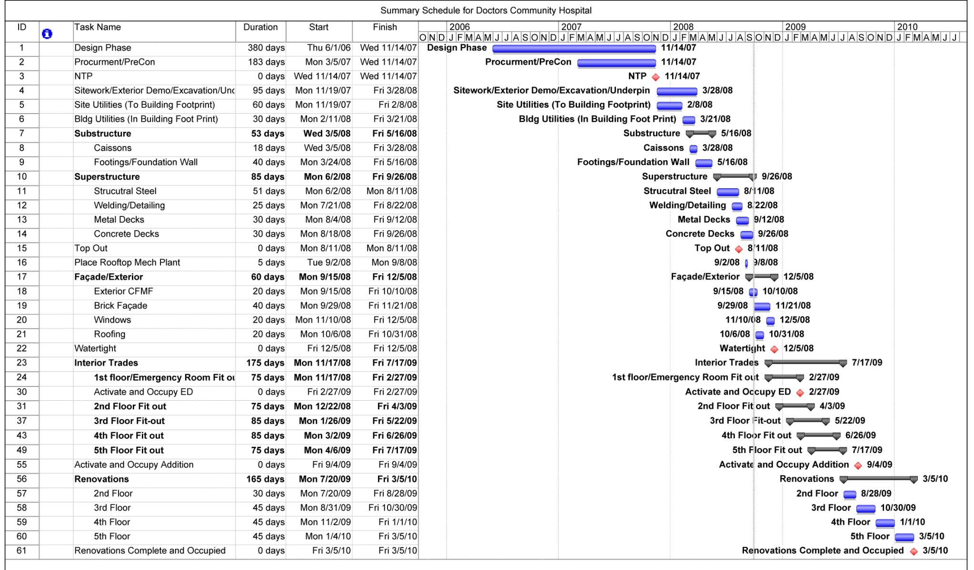
Project Overview
Cost Breakdown
 |  | Cost | Cost/SF
Total Project (Original) |  | $ 31,318,000 | $ 157
Total Building (Original) |  | $ 26,413,000 | $ 132
Systems
 | Mechanical | $ 9,203,000 | $ 46
 | Structural Steel | $ 1,554,000 | $ 8
 | Electrical | $ 3,084,000 | $ 15
 | Masonry | $ 1,052,000 | $ 5
 | Concrete | $ 1,035,000 | $ 5
 | Sprinkler | $ 444,500 | $ 2
Cost and Schedule Summary
  29 Month Project, with three critical Milestones
    ED Expansion complete, Patient Tower Expansion Compete, Renovations Complete
  Approx $31 Million original cost
    Currently about $37 Million with added scope change orders
Project Overview
BIM Execution Planning Analysis
Prefabricated Façade Analysis
  Demonstration of Breadth
Site Logistics Analysis
Final Conclusions
Q & A

Slide 6
Analysis 1
Building Information Modeling
Execution Planning

Slide 7
BIM Execution Planning
BIM Uses
  3D MEP Coordination, Phase Planning, 4D Modeling, Virtual Mock-ups, Cost Estimation, Energy Analysis, Structural Analysis, Record Models, Building Maintenance…
What is Building Information Modeling (BIM)?
  “process of designing, analyzing, integrating, and documenting a building’s lifecycle by developing an intelligent virtual prototype of the building using a database of information” – PSU CIC
Current Industry Issues
  How do we implement BIM?
  What uses are right for our project?
Project Overview
BIM Execution Planning Analysis
Prefabricated Façade Analysis
  Demonstration of Breadth
Site Logistics Analysis
Final Conclusions
Q & A

Slide 8

BIM Execution Planning
How to Implement?
Goals for my BIM Related Thesis Work:
Develop generic process model for 3D MEP Coordination
Compare 2D coordination at DCH to 3D Process
Define implementation process for 3D Coordination at DCH
Project Overview
BIM Execution Planning Analysis
Prefabricated Façade Analysis
  Demonstration of Breadth
Site Logistics Analysis
Final Conclusions
Q & A

Slide 9
Developing a Process
Input from Industry Professionals
  Balfour Beatty, Jacobs, Gilbane
Discussions with Graduate students
Research of Academic work
Results
  Definition of common process traits
  Used to establish the process model for 3D MEP Coordination
Project Overview
BIM Execution Planning Analysis
Prefabricated Façade Analysis
  Demonstration of Breadth
Site Logistics Analysis
Final Conclusions
Q & A

Slide 10
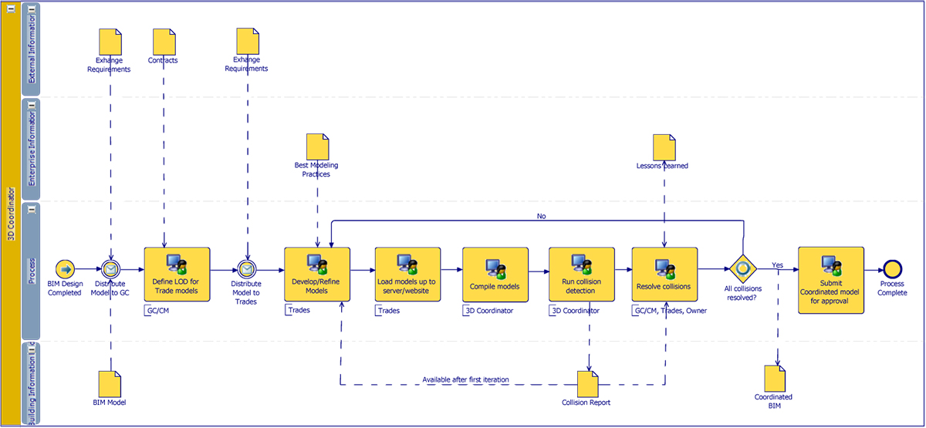
Process
Developed using Business Process Modeling Notation (BPMN)
  TIBCO Software
Project Overview
BIM Execution Planning Analysis
Prefabricated Façade Analysis
  Demonstration of Breadth
Site Logistics Analysis
Final Conclusions
Q & A

Slide 11
Comparison to DCH
DCH used 2D coordination
  Overlay 2D CAD Drawings
  Light-tables
Interesting finding:
  Process did not change in any appreciable way, only the tools
Project Overview
BIM Execution Planning Analysis
Prefabricated Façade Analysis
  Demonstration of Breadth
Site Logistics Analysis
Final Conclusions
Q & A

Slide 12
Implementing 3D Coordination at DCH
Assets
  Can leverage Gilbane’s internal experience
  Interested in the process
  Some trades have experience
Major Questions to Address:
  Project team assets?
  Trades?
  Level of Detail?
  File Exchange requirements?
  Coordination meeting?
  Weekly Coordination Cycle?
Trades for 3D Coordination
Steel | HVAC
Plumbing | Electrical
Medical Gas | Sprinkler
Pneumatic Tubing | Cable trays
Project Overview
BIM Execution Planning Analysis
Prefabricated Façade Analysis
  Demonstration of Breadth
Site Logistics Analysis
Final Conclusions
Q & A

Slide 13
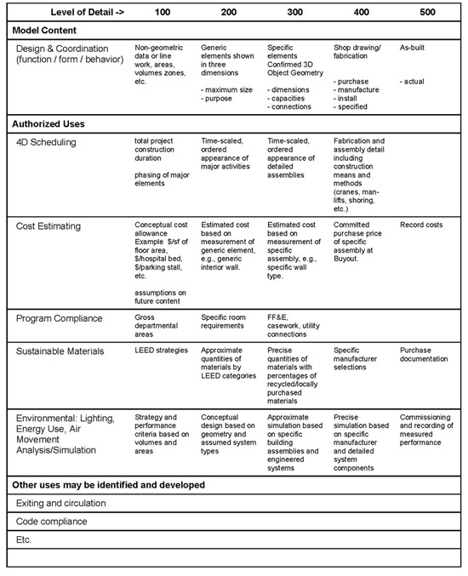
Implementing 3D Coordination at DCH
Level of Detail
  Defined from Model Progression Specification
Major Questions to Address:
  Project team assets?
  Trades?
  Level of Detail?
  File Exchange requirements?
  Coordination meeting?
  Weekly Coordination Cycle?
File Exchange Requirements
  Specify compatible formats, not program specific
    Ex: Must be Navisworks compatible
Project Overview
BIM Execution Planning Analysis
Prefabricated Façade Analysis
  Demonstration of Breadth
Site Logistics Analysis
Final Conclusions
Q & A

Slide 14
Implementing 3D Coordination at DCH
Monday- Post files to server
Tuesday- GC compiles collision model
Wednesday- Coordination Meeting
Thursday- Subs update model
Friday- Subs update model
Coordination Meeting
  Conduct weekly at the jobsite trailer
  Team lacks experience to possible conduct interactively
Major Questions to Address:
  Project team assets?
  Trades?
  Level of Detail?
  File Exchange requirements?
  Coordination meeting?
  Weekly Coordination Cycle?
Project Overview
BIM Execution Planning Analysis
Prefabricated Façade Analysis
  Demonstration of Breadth
Site Logistics Analysis
Final Conclusions
Q & A
Image Courtesy of BBC

Slide 15
Analysis 2
Prefabricated Façade

Slide 16
Prefabrication at DCH
Why choose prefabrication?
  Construction time reduced
    Façade on the Critical Path
  Work performed in Warehouses (controlled conditions)
    Brick façade scheduled to go into winter months
Goals of Analysis
  Analyze impacts of changing envelope on schedule and cost
  Asses impact on structure
  Asses impact on mechanical system
Project Overview
BIM Execution Planning Analysis
Prefabricated Façade Analysis
  Demonstration of Breadth
Site Logistics Analysis
Final Conclusions
Q & A

Slide 17
System Selection
Criteria | CarbonCast | Nitterhouse | Brick Facade
Ability to Match Existing? | A variety of brick finishes can be matched through the use of Thin Brick inlays to the system | Also, using ThinBricks, this product can match a variety of finishes. | Existing building is hand laid brick, so matching is easy
Cost of System? | $37/SF delivered and installed | $35/SF delivered and installed | $28/SF installed
Weight of System? | 65 lbs/SF | 75 lbs/SF | 42 lbs/SF
Insulation properties? | R-Value: 5.4 | R-Value: 0.48 | R-Value: 0.44
Analyzed two alternative prefabricated solutions
  CarbonCast from High Concrete
  Precast panels from Nitterhouse
Project Overview
BIM Execution Planning Analysis
Prefabricated Façade Analysis
  Demonstration of Breadth
Site Logistics Analysis
Final Conclusions
Q & A

Slide 18
Schedule Impact
Schedule Comparison
Hand-laid Brick Façade | 40
Precast | 10
Net Difference | Save 30 Days
Precast by the Numbers
Total Façade Area | 37,127 SF
Average Panel Size | 250 SF
Panels Needed | 148
Panels Erected Per Day | 15
Total Duration | 10 Days
Reduce construction time of the façade
Project Overview
BIM Execution Planning Analysis
Prefabricated Façade Analysis
  Demonstration of Breadth
Site Logistics Analysis
Final Conclusions
Q & A
6 weeks saved
  Demobilize January 1, 2010 instead of February 12, 2010

Slide 19
Cost Impact
Affects on Cost
  Initial Cost
  Impact on General Conditions
  Incidental costs due to change in construction methods
Summary of Financial Impact
Total Added Cost of System | $ 321,280
Total GC Savings | $ 86,588
Added Cost for Lift | $ 3,100
Net Cost | $ 237,792
Net Cost as % of Façade | % 22.5
Net Cost as % of Total Project | % 0.69
Project Overview
BIM Execution Planning Analysis
Prefabricated Façade Analysis
  Demonstration of Breadth
Site Logistics Analysis
Final Conclusions
Q & A

Slide 20
Structural Impact
Existing System
  Brick façade supported by steel angle
    Load path for façade travels to exterior beam
New System
  CarbonCast connects directly to column
    Load path for façade only on column
Project Overview
BIM Execution Planning Analysis
Prefabricated Façade Analysis
  Demonstration of Breadth
Site Logistics Analysis
Final Conclusions
Q & A

Slide 21
Structural Impact
Analyze Exterior Beam
  Opportunity to downsize?
Analyze Column
  Ensure can handle additional load
Key Assumptions
  100 PSF Live Load
  Can use Live Load reduction
  Allow 15 PSF for suspended misc. items
  43 PSF for steel deck from Vulcraft Manual
Project Overview
BIM Execution Planning Analysis
Prefabricated Façade Analysis
  Demonstration of Breadth
Site Logistics Analysis
Final Conclusions
Q & A

Slide 22
Structural Impact
Typical Exterior Beam (W16x36)
Tributary Area | 288 SF
Reduced Live Load | 87.5 PSF
Dead Load (Deck + misc) | 58 PSF
Max Moment (excluding existing façade) | 151.2 kip ft
Moment due to existing facade | 41.2 kip ft
Total Moment on Beam as designed | 192.4 kip ft
Column Calc 1 (W8x35)
Tributary Area | 864 SF
Reduced Live Load | 50 PSF
Dead Load (Deck + misc) | 58 PSF
Axial Load (excluding new façade) | 129.2 kips
Axial Load (Due to new façade) | 57 kips
Total Axial Load on Column | 186.2 kips
Column Calc 2 (W8x58)
Tributary Area | 1440 SF
Reduced Live Load | 44 PSF
Dead Load (Deck + misc) | 58 PSF
Axial Load (excluding new façade) | 201.6kips
Axial Load (Due to new façade) | 95.1 kips
Total Axial Load on Column | 296.7 kips
Project Overview
BIM Execution Planning Analysis
Prefabricated Façade Analysis
  Demonstration of Breadth
Site Logistics Analysis
Final Conclusions
Q & A
151.2 < 240 Max
186.2 < 300 Max
296.7 < 514 Max

Slide 23
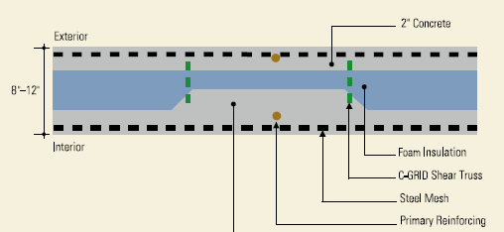
Mechanical Impact
Summer Heat Gain
System | Area (SF) | U-Value | ΔT (F) | Heat Gain (MBTU's) | Heat Gain (Tons)
Brick Façade | 37,127 | 0.0457 | 23 | 114,263 | 9,522
CarbonCast | 37,127 | 0.0386 | 23 | 96,511 | 8,043
 |  |  |  | Difference (Tons) | 1,479
 |  |  |  | Difference (kWh) | 5,198
 |  |  |  | Savings @ $.128 per kWh | $ 665.32
Brick Façade
Component | R-Value | Thickness (in.) | Total R-Value
Outside Air Film | 0.17 | - | 0.17
Brick | 0.11 | 4 | 0.44
Air Gap | 0.94 | 1 | 0.94
Ext. Gyp Board | 0.63 | 0.63 | 0.40
Batt Insulation | 3.14 | 6 | 18.84
Int. Gyp Board | 0.63 | 0.63 | 0.40
Inside Air Film | 0.68 | - | 0.68
 |  | Total | 21.86
 |  | U-Value | 0.0457
 | CarbonCast | Brick
Total R-Value | 25.88 | 21.86
Total U-Value | ..0387 | .0457
New System has lower U-Value
  Reduces summer heat gain and winter heat loss
  Translates to energy savings
Project Overview
BIM Execution Planning Analysis
Prefabricated Façade Analysis
  Demonstration of Breadth
Site Logistics Analysis
Final Conclusions
Q & A
Savings Analysis
Cooling Savings | $ 665.32
Heating Savings | $2,082.73
Total Annual Savings | $2,748.05
Payback Period | 86.24 years
CarbonCast
Component | R-Value | Thickness (in.) | Total R-Value
Outside Air Film | 0.17 | - | 0.17
Concrete | 0.08 | 3 | 0.24
XPS (Extruded Polystyrene) | 5.00 | 1 | 5.00
Concrete | 0.08 | 2 | .16
Ext. Gyp Board | 0.63 | 0.63 | 0.40
Batt Insulation | 3.14 | 6 | 18.84
Int. Gyp Board | 0.63 | 0.63 | 0.40
Inside Air Film | 0.68 | - | 0.68
 |  | Total | 25.88
 |  | U-Value | 0.0386
Winter Heat Loss
System | Area (SF) | U-Value | ΔT (F) | Heat loss (MBTU)
Brick Façade | 37,127 | 0.0457 | 72 | 357,692
CarbonCast | 37,127 | 0.0386 | 72 | 302,121
 |  |  | Difference (MBTU) | 55,571
 |  |  | Difference (kWh) | 16,271
 |  |  | Savings @ $.128 per kWh | $ 2,082.73

Slide 24
Analysis 3
Site Logistics

Slide 25
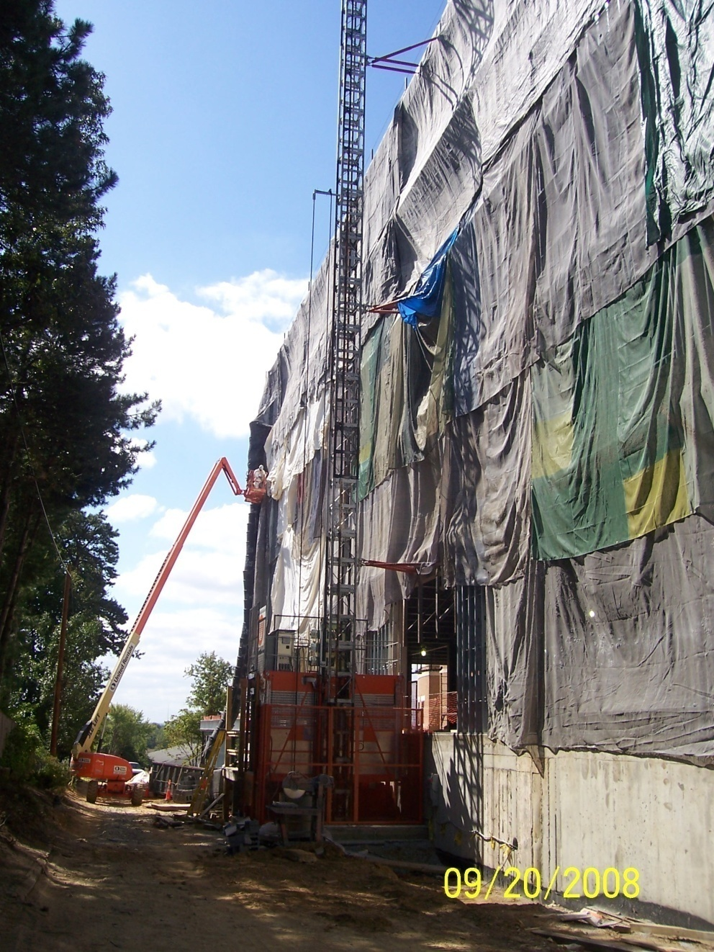
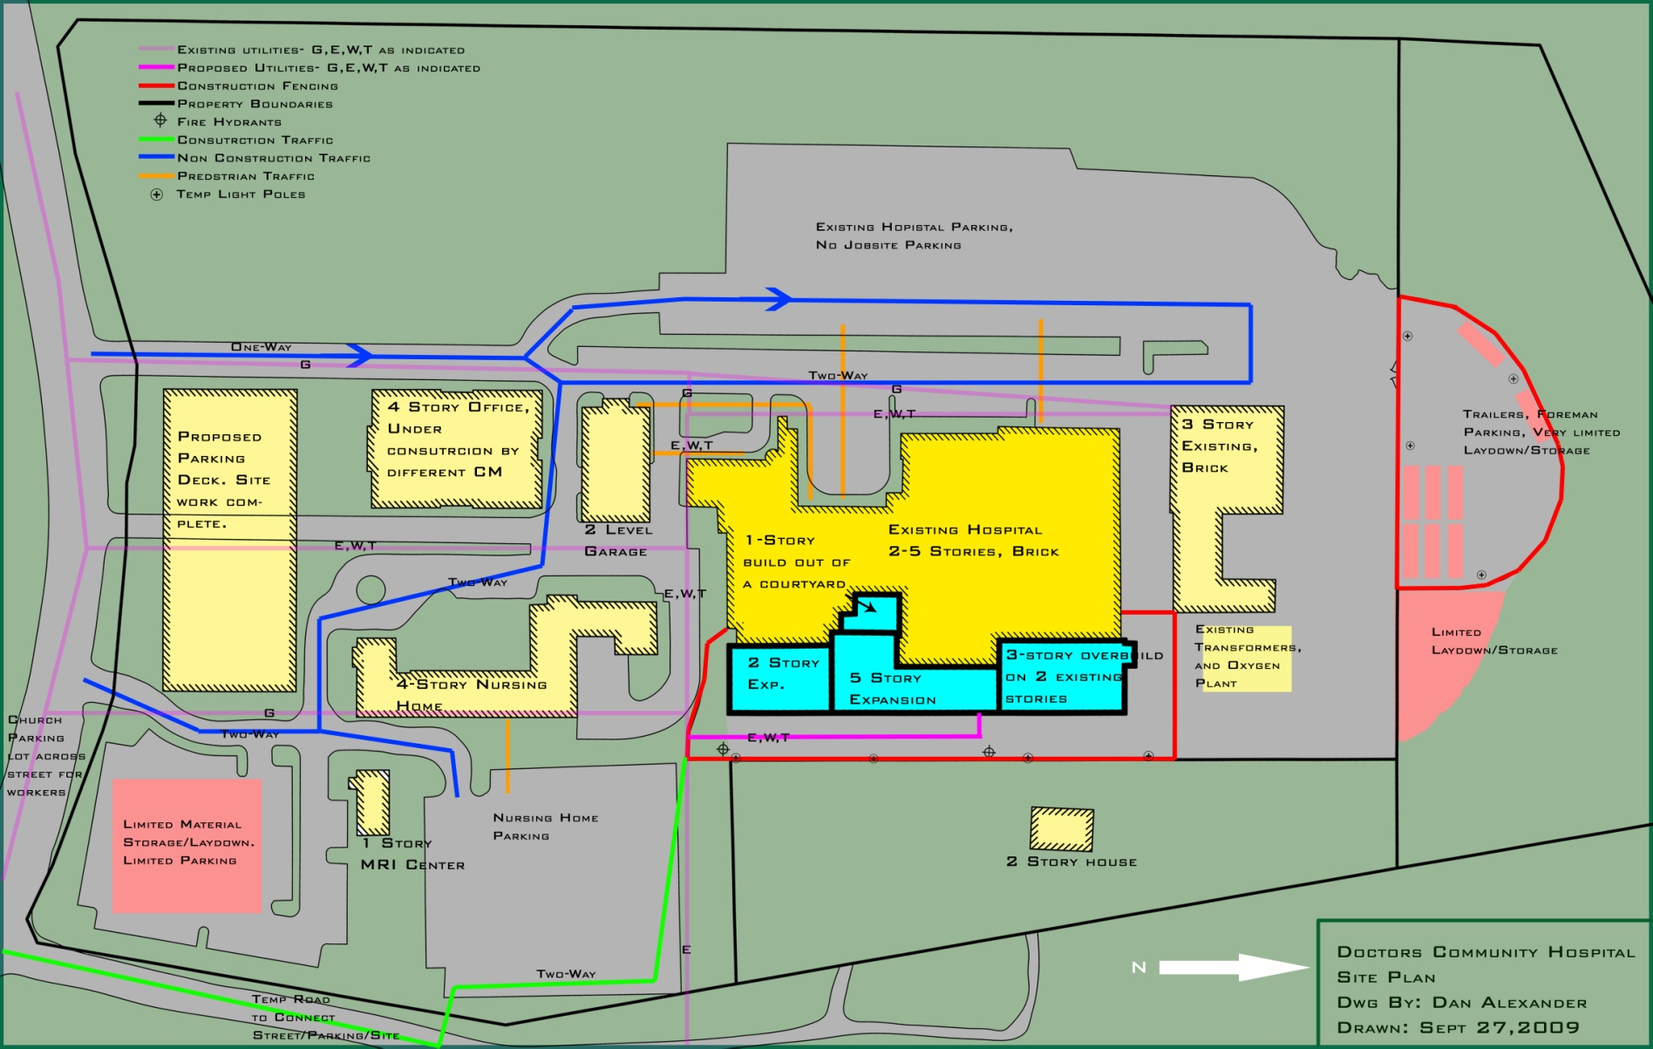
Site Congestion
Limited access to site
  One access road
  Could not access all sides of project
  Road often extremely congested
Goals of Analysis
  Assess if there was an impact from the congested site
  Quantify in terms of schedule and cost
  Determine if purchasing adjacent property is a sound investment
Project Overview
BIM Execution Planning Analysis
Prefabricated Façade Analysis
  Demonstration of Breadth
Site Logistics Analysis
Final Conclusions
Q & A

Slide 26
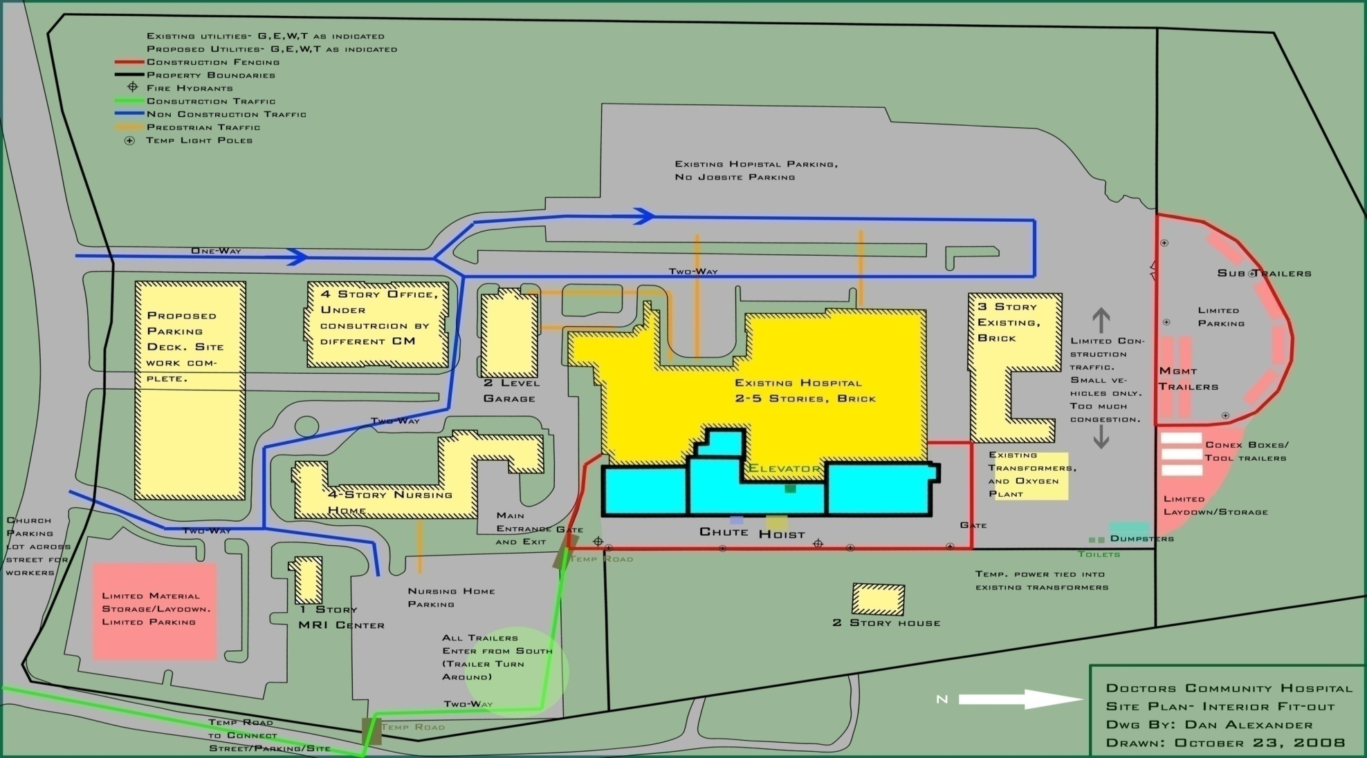
Effects of Congestion
Material Storage Location
  No space near building
  Storage located far away
    Up to 4 football fields in some cases
  Results in manpower inefficiencies!
    More time retrieving materials (Longer hauls)
    Double handle materials
    Breaks get extended
Project Overview
BIM Execution Planning Analysis
Prefabricated Façade Analysis
  Demonstration of Breadth
Site Logistics Analysis
Final Conclusions
Q & A

Slide 27
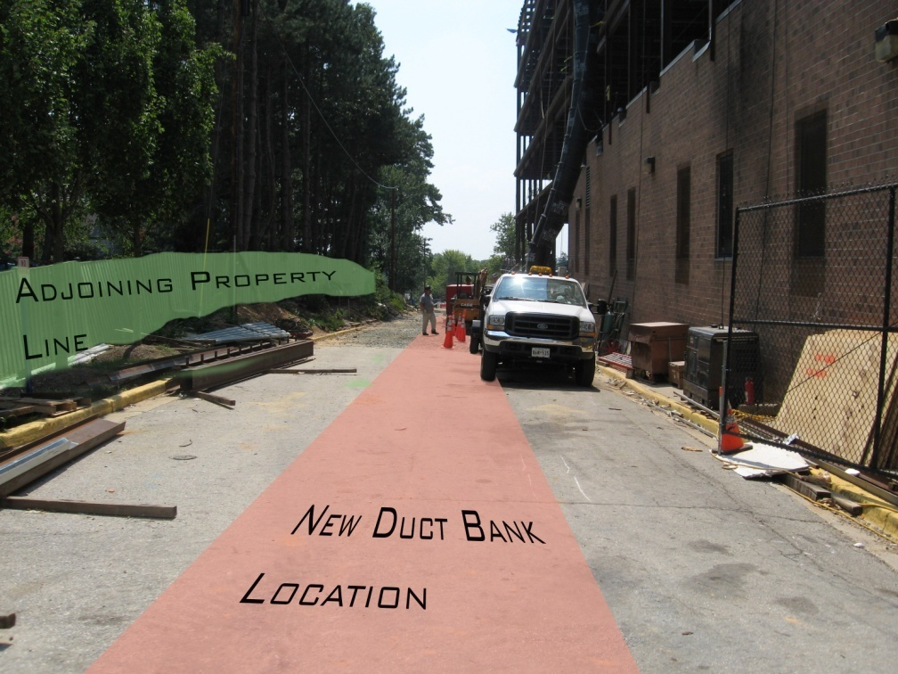
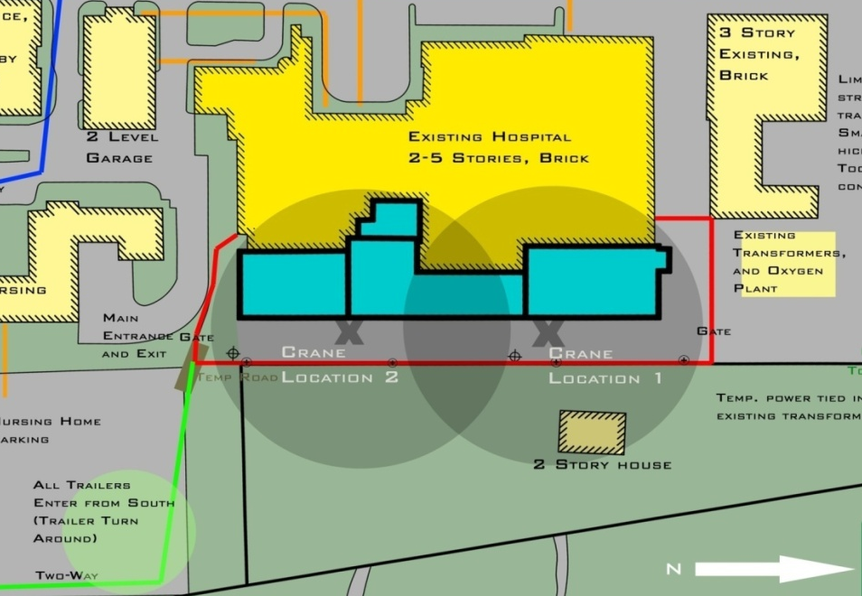
Effects of Congestion
Many early trades were affected
  Steel Contractor
    Used road as laydown sometimes
    Had to shutdown operations
  Underground MEP
    Location of ductbank on access road
    Had to mobilize more than once
Project Overview
BIM Execution Planning Analysis
Prefabricated Façade Analysis
  Demonstration of Breadth
Site Logistics Analysis
Final Conclusions
Q & A

Slide 28
Schedule and Cost Impact
Source of Savings | Approx. Contract | Savings % | Savings $
Steel | $1,550,000 | 5% | $ 77,500.00
Mech/ Plumbing | $9,200,000 | - | $ 150,000.00
Electrical | $3,000,000 | 5% | $ 150,000.00
Masonry | $1,000,000 | 10% | $ 100,000.00
Concrete | $1,000,000 | - | $ 15,000.00
GC’s | $14,430/wk | 8 wks | $ 115,440.00
Total Savings |  |  | $607,940
Based on input from Project Managers of the various trades
  Relied on the years of experience and their professional opinion
Trade | Schedule Impact | Impact in Days on CPM | Cost Impact
Steel | Shorten 15-20% | 9 | Save 5-10%
Mechanical/Plumbing | Shorten 25% (Underground) | 15 | Save $150,000
Electrical | Shorten 15% | 4 | Save 5%
Masonry | Shorten 10-15% | 5 | Save 10%
Concrete | Shorten 5-10% | 7 | Save $15,000
Project Overview
BIM Execution Planning Analysis
Prefabricated Façade Analysis
  Demonstration of Breadth
Site Logistics Analysis
Final Conclusions
Q & A

Slide 29
Adjacent Property
Add considerable area for the project team to utilize
Several opportunities to buy
  2-3 years ago @ $500,000 offered by land owner
  1.5 years ago, DCH offered $ 1 Million
  Owner holding out for $ 2 Million
Project Overview
BIM Execution Planning Analysis
Prefabricated Façade Analysis
  Demonstration of Breadth
Site Logistics Analysis
Final Conclusions
Q & A

Slide 30
Effects of Land on Project
Move ductbank away from building
  Reduce congestion near the building footprint
Storage area closer
  Improve manpower efficiency
Redesign altogether
  Stand alone structure with walkways
Unfortunately, Cost of $ 2 Million is not offset by savings of $ 600,000
  Do not recommend the purchase
Project Overview
BIM Execution Planning Analysis
Prefabricated Façade Analysis
  Demonstration of Breadth
Site Logistics Analysis
Final Conclusions
Q & A

Slide 31
Final Conclusions
Site Logistics
  Can improve schedule by 8 weeks
  Upfront costs not outweighed by returns
BIM Execution Analysis
  Successfully Generated a process map
  Successfully outlined implementation procedures
Prefabrication Analysis
  Shorten Duration by 6 Weeks,
  No Structural impact
  Minimal Energy costs savings
  Costs do not outweigh returns
Project Overview
BIM Execution Planning Analysis
Prefabricated Façade Analysis
  Demonstration of Breadth
Site Logistics Analysis
Final Conclusions
Q & A

Slide 32
Project Overview
BIM Execution Planning Analysis
Prefabricated Façade Analysis
  Demonstration of Breadth
Site Logistics Analysis
Final Conclusions
Q & A
QUESTIONS?

Slide 33
THANK YOU!

